Slide 1
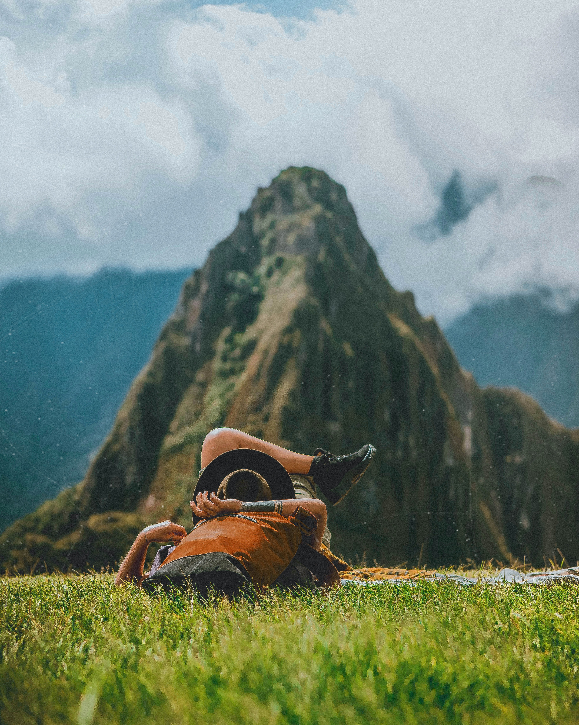
PR2761 Capstone Project II By: Marcus Pickett, Liam Dyer Computer Systems Engineering Tech Due: July 30, 2026
Duck Hunting/Identifying Guide iOS App
1

Slide 2
Acknowledgement
Thank you, Professor Hogan, for suggesting using the python script
Thank You, Cornell university for letting us you their bird library
Thank you, CodeWithChris for teaching us more swift Xcode.

Slide 3
Introduction and Scope
Project Goal: The goal is to develop an IOS app that helps duck hunters and bird watchers with identifying duck species in Newfoundland and Labrador, while also making navigation easier and improving outdoor safety.
Features:
Machine learning-based duck species identification.
GPS waypoint creation and navigation
Duck species database.
Habitat and behavioral information.
Live weather details using an API.
Benefits:
ML improves the species identification accuracy.
Provides info for ethical and legal hunting regulations.
GPS/Map reduces the risk of becoming lost.
Provides info specific to Newfoundland and Labrador duck species.

Slide 4
Background
Newfoundland contains a vast number of wetlands, lakes, and forests that make navigation difficult and time consuming.
Current apps in the IOS store provide little support for Canadian duck species.
Accurate species identification is important for wildlife conservation and hunting regulations.
Machine learning has achieved approximately 96.8% accuracy in wildlife image classification (Tabak et al., 2020).

Slide 5
Problem Statement
Newfoundland and Labrador is covered in many Remote hunting locations
These locations are often difficult to navigate through
Species can easily be misidentified
Hunting regulation compliance
Integrated solution needed, creating an application that uses species identification and GPS navigation

Slide 6
Studies
Course lectures and lab exercises in iPhone dev CP3810, paired with online sources and instructional videos aided in:
Planning the application layout
Learning to train a machine learning model
Developing the application
Performing testing

Slide 7
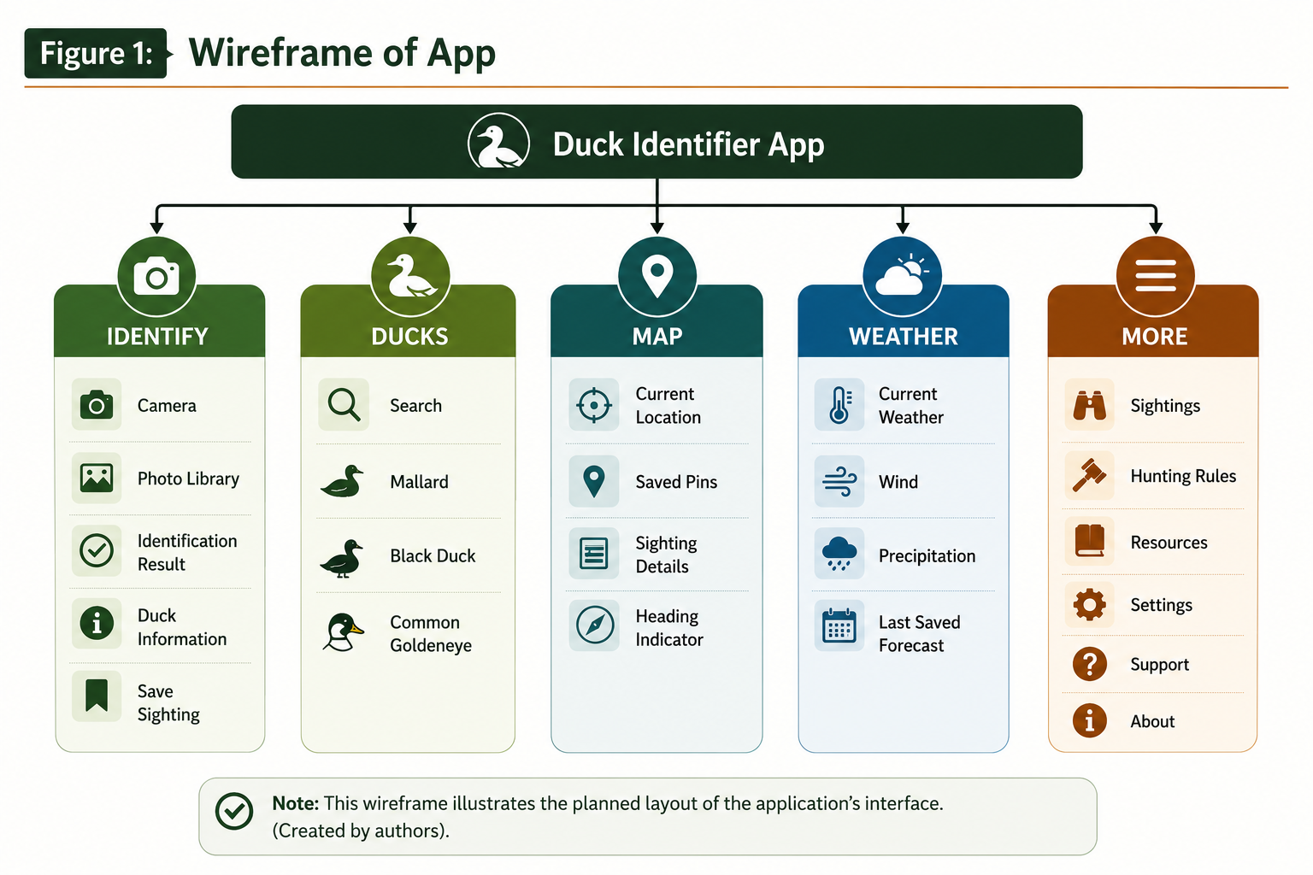
System Design
The Duck ID application is organized into five main modules to allow a user-friendly interface.
Note. This wireframe illustrates the planned layout of the application’s interface (Created by authors). The illustration was created by AI.

Slide 8
Python Script & Macaulay Library
We created a python script to extract the data from Macaulay’s Library.
Restrictions were made to extract only male and female mallards by using classes like Sex().
The script creates a trail system containing a testing, training, validation folder filled with a certain number of pictures.
We used Macaulay Library duck dataset for the images.
Macaulay Library is a public library of birds created by the Cornell University.
Panda’s library

Slide 9
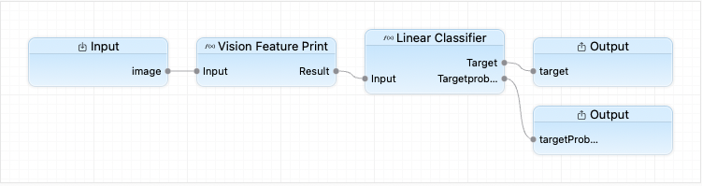
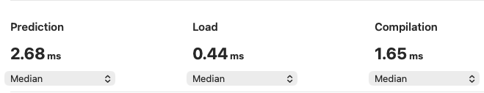
Create ML
Figure 2: ML Structure and Metrics
Create ML model using Core ML
Trained with Mallard image dataset
ML model has 93% validation accuracy
Vision integration
Note. Data retrieved from Apple's Core ML software while testing the ML model.

Slide 10
Duck ID Code
MVVM Breakdown
The architectural design of the code is Model-View-View-Model (MVVM).
MVVM is used to isolate front end user interfaces from the back end.
Reduces dependencies creating easy to maintain, test and expand.
The Models defines data structures.
Responsible from transferring data
The Service Layer is responsible for communicating between data, requests, external frameworks, and local storage.
The ViewModels are connections between the models and user interface.
SwiftUI automatically detects changes in the interface and updates it.
The Views displays all the information you see on the interface.

Slide 11
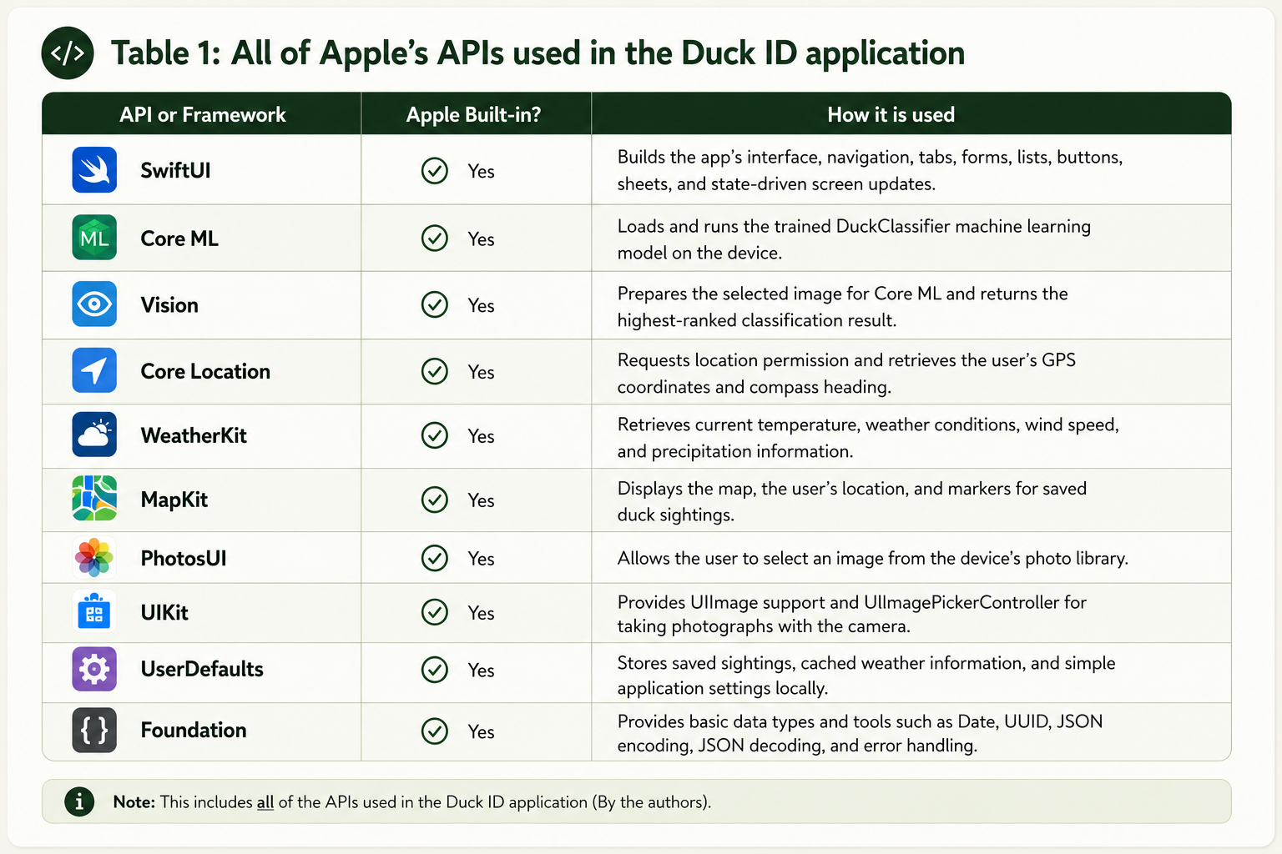
API Integration

Slide 12
Testing and Evaluation
Functional feature testing on major features
Machine learning validation
GPS accuracy verified
Weather data confirmed
Local storage tested
ML has 93% accuracy
Navigation function works correctly
Weather updates successfully
User data saved locally after use

Slide 13
Conclusion and Recommendations
Objectives achieved
Machine model successful trained
Navigation integrated
Strong project foundation
Future expansion possible
Provide offline functionality
Use larger datasets for ML
Create android compatibility
Hunting log feature
Apple App Store release

Slide 14
References
CodeWithChris. (2024, December 12). How to make an app in 8 days (2025 full tutorial) [Video]. YouTube. https://www.youtube.com/watch?v=uvLUJev1F20
Cornell University. (2026). Mallard - Anas platyrhynchos - media search - Macaulay Library and ebird. https://search.macaulaylibrary.org/catalog?taxonCode=mallar3
freeCodeCamp.org. (2019, December 16). APIs for beginners – How to use an API (Full course / tutorial) [Video]. YouTube. https://www.youtube.com/watch?v=WXsD0ZgxjRw
Statistics Canada. (2015, November). Forest land by province and territory (Table 3.7). https://www150.statcan.gc.ca/n1/pub/16-201-s/2011001/t015-eng.htm
Tabak, M. A., Norouzzadeh, M. S., Wolfson, D. W., Sweeney, S. J., VerCauteren, K. C., Snow, N. P., Halseth, J. M., Di Salvo, P. A., Lewis, J. S., White, M. D., Teton, B., Beasley, J. C., Schlichting, P. E., Boughton, R. K., Wight, B., Newkirk, E. S., Ivan, J. S., Odell, E. A., Brook, R. K., ... Miller, R. S. (2020). Improving the accessibility and transferability of machine learning algorithms for identification of animals in camera trap images: MLWIC2. https://onlinelibrary.wiley.com/doi/10.1002/ece3.6692
UlJah, W. (1992, January). Water Resources Atlas of Newfoundland. https://www.gov.nl.ca/ecc/files/waterres-cycle-hydrologic-water-resources-atlas-of-newfoundland-1992.pdf
14

Slide 15
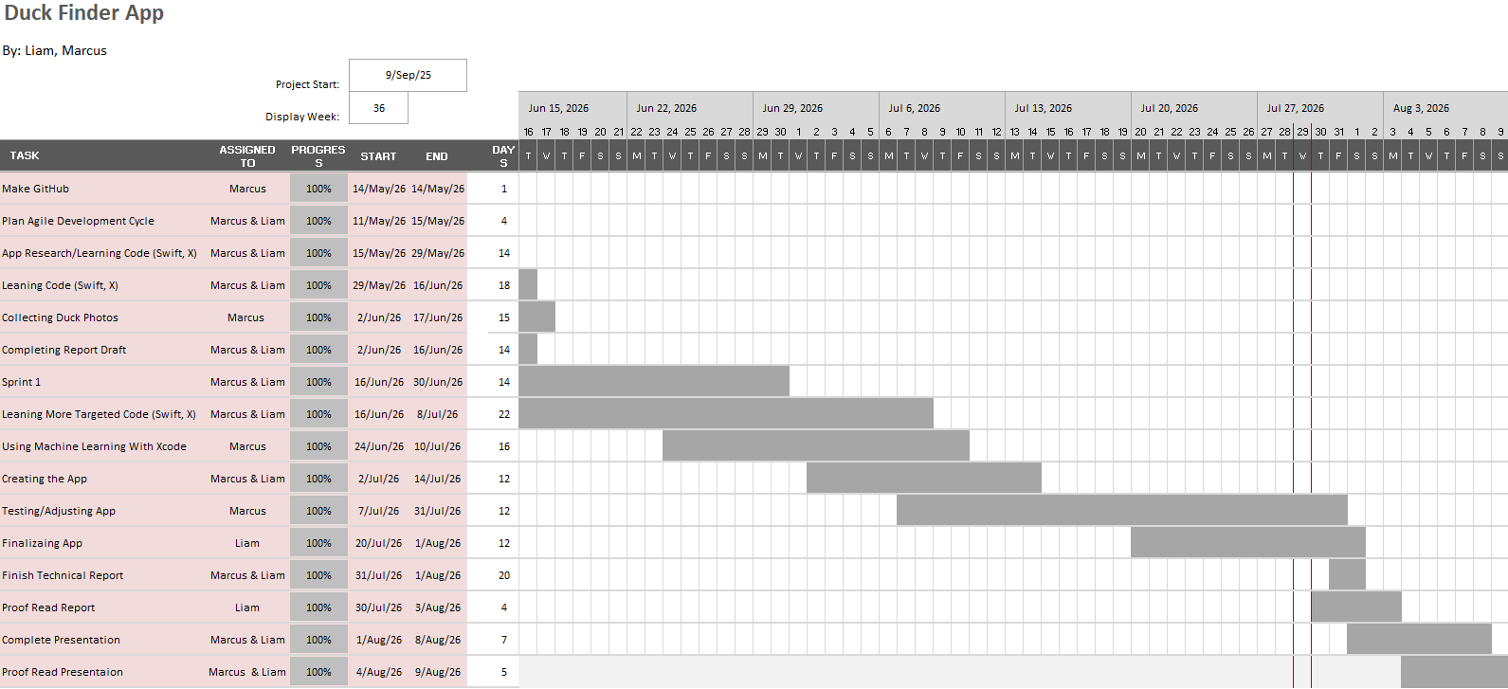
Gantt Chart
15

